Slide 1
Topic: Data EQ: When is it better to use a histogram to display data?
Year 11 Essentials

Slide 2
Five Questions
Topic: Data
Date:
EQ – Explain how frequency distribution tables can be used?
Write 0.6 as a fraction and a percentage?
If w³ = 27, what is w?
Use an appropriate strategy to calculate 14.6 x 4
A 1Lbottle of milk costs $1.98. If I use 1 bottle per day, how much would I pay for milk per week?
Give the mode, median, Q1, Q3 and the range for the following data:
{6, 7, 20, 12, 12, 12, 19, 21, 23, 25, 17, 19, 14}
Notes:
3/5 and 60%
3
58.4
13.86
Mode = 12
Median = 17
Range = 19
Q1 = 12
Q3 = 20.5

Slide 3
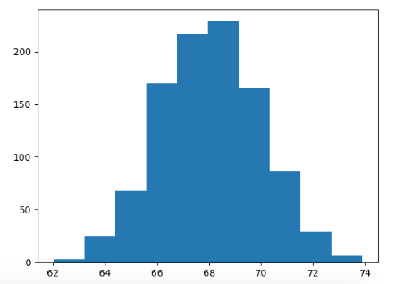
24
7
30
Topic: Data
Date:
EQ – Explain how frequency distribution tables can be used?
Histograms are used when there are too many data points to display using a dot plot. They are used to show frequency distribution for larger sets of continuous numerical data, with the x axis displaying continuous numerical data and the y showing the frequency.
What is a histogram?
WICOR
Notes:
Check for understanding!
What is numerical data?
What is categorical data?
What is discrete data?
What makes data continuous?

Slide 4
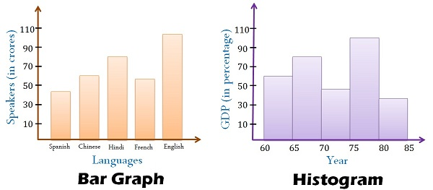
A histogram looks a lot like a column graph but there are a couple of key differences.
Gaps
No Gaps
Data is categorical and bars can be swapped around
Data is continuous numerical and columns cannot be swapped around

Slide 5
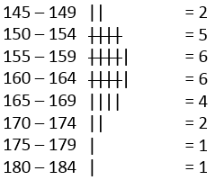
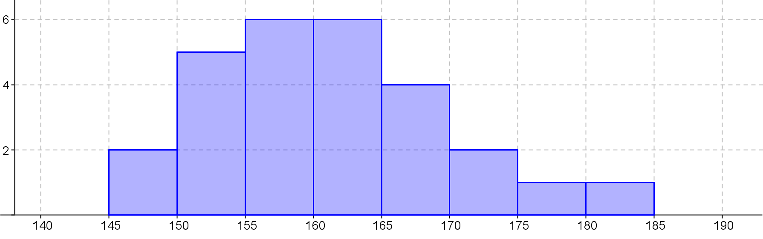
24
7
30
Topic: Data
Date:
EQ – Explain how frequency distribution tables can be used?
List the steps to create a histogram?
Look at the range of the data to help decide on a “class width”.
Use the class width to create a frequency table.
Create a set of Axis that will accommodate all the data we wish to show.
Use the frequency data from the frequency table to complete the graph and add a title.
Heights of students in 8-7
Title
No Gaps between the columns
Frequency
WICOR
Labels
Height(cm)
Notes:
Check for understanding!
What is numerical data?
What is categorical data?
What is discrete data?
What makes data continuous?

Slide 6
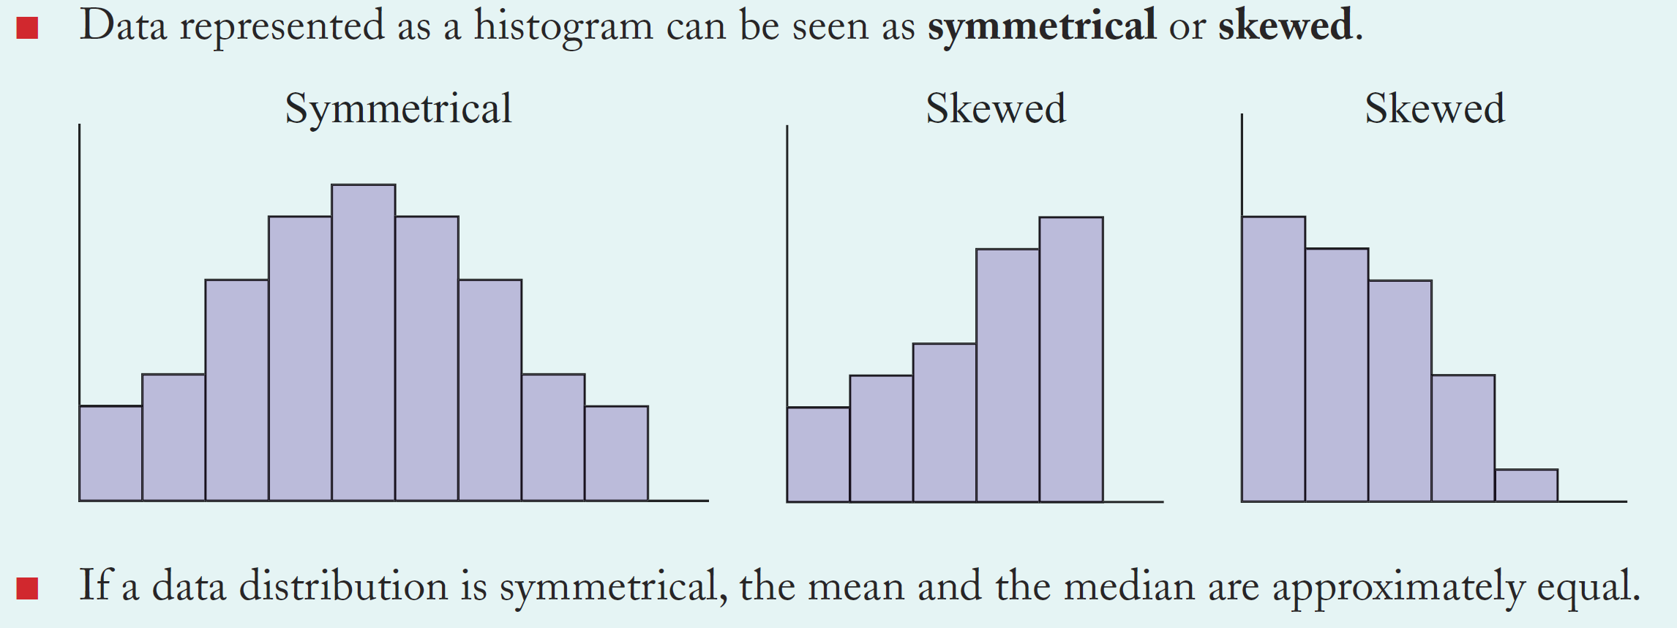
24
7
30
Topic: Data
Date:
EQ – Explain how frequency distribution tables can be used?
What does skew look like on a histogram?
A distribution is symmetrical if a vertical line can be drawn at some point in the histogram such that the shape to the left and the right of the vertical line are mirror images of each other.
WICOR
Notes:
Check for understanding!
What is numerical data?
What is categorical data?
What is discrete data?
What makes data continuous?

Slide 7
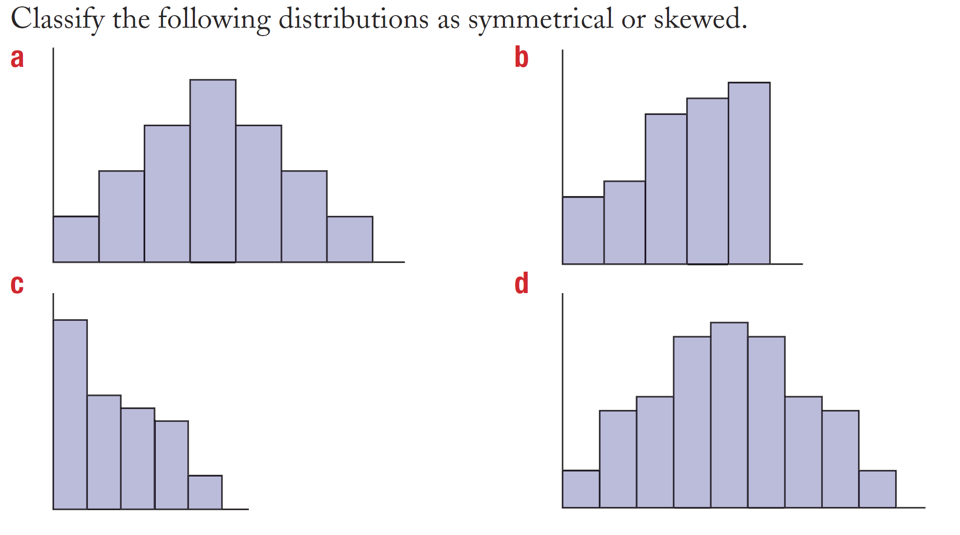

Slide 8
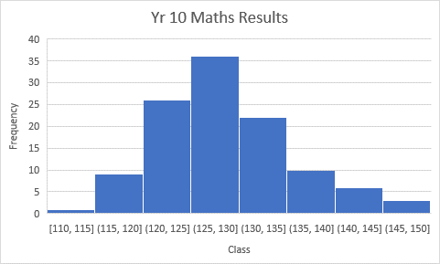
See the histogram made from the previous lesson:
Bin | Frequency
110 - <115 | 1
115 - <120 | 8
120 - <125 | 25
125 - <130 | 35
130 - <135 | 21
135 - <140 | 9
140 - <145 | 5
145 - <150 | 3
>150 | 0
Total (∑) | 107
Complete the following questions:

Slide 9
Interleaved Textbook pg. 110
Examine the frequency table and histogram on the previous page and answer the following questions: 1. Looking at the x axis, why do the columns need to touch?
2. Looking at the brackets on the X axis, why is the left bracket rounded and the right square?
3. The numbers on the X axis could be written as a scale, instead of brackets. Where would the columns touch if there was a scale?
4. Describe the shape and skew of the data.
5. How would you calculate the MMMR and Q1 and Q3 from this data?

Slide 10
Task
Complete Apply Q4-13 from your Interleaved Textbook pg. 110

Slide 11
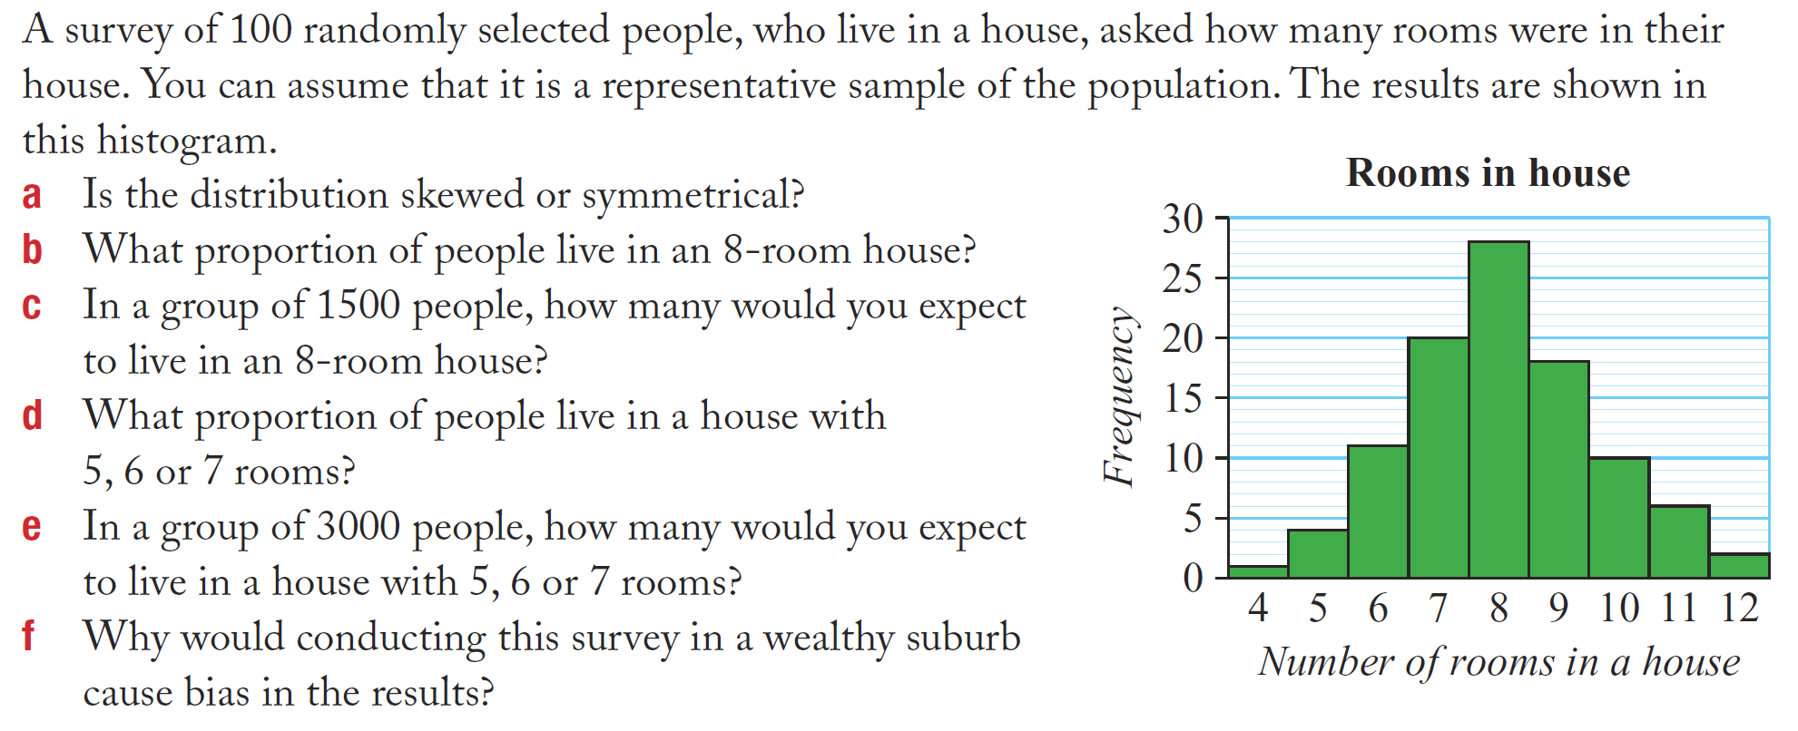
Further application

Slide 12
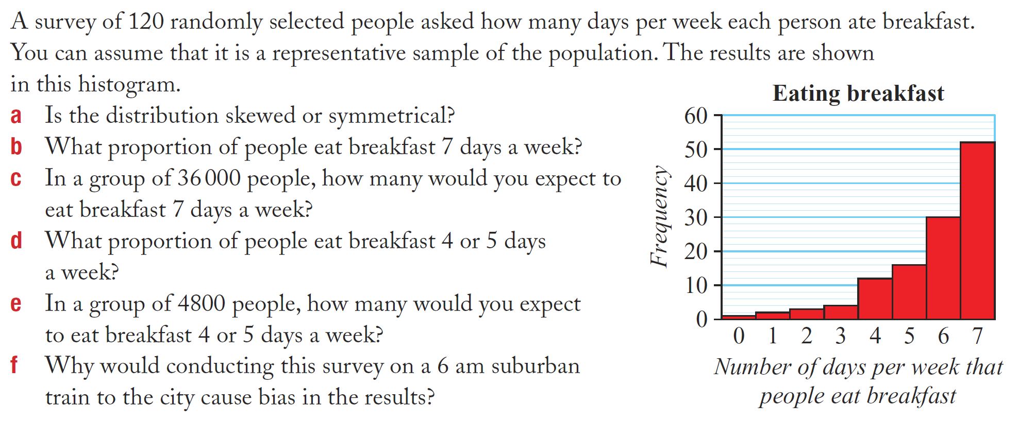
Further application

